Slide 1

Greeco
Greener Communities, Better Lives

Slide 2
Motivation
Parts of cities such as Hamilton & Toronto can be neglected
Clean city = longer, healthier lives
Need a croudsourced platform to identify problem areas

Slide 3
Our solution – Greeco (Green Community)
Web-based platform, allowing users to rate locations based on cleanliness on the go.
Allows citizens and governments to identify problem areas

Slide 4
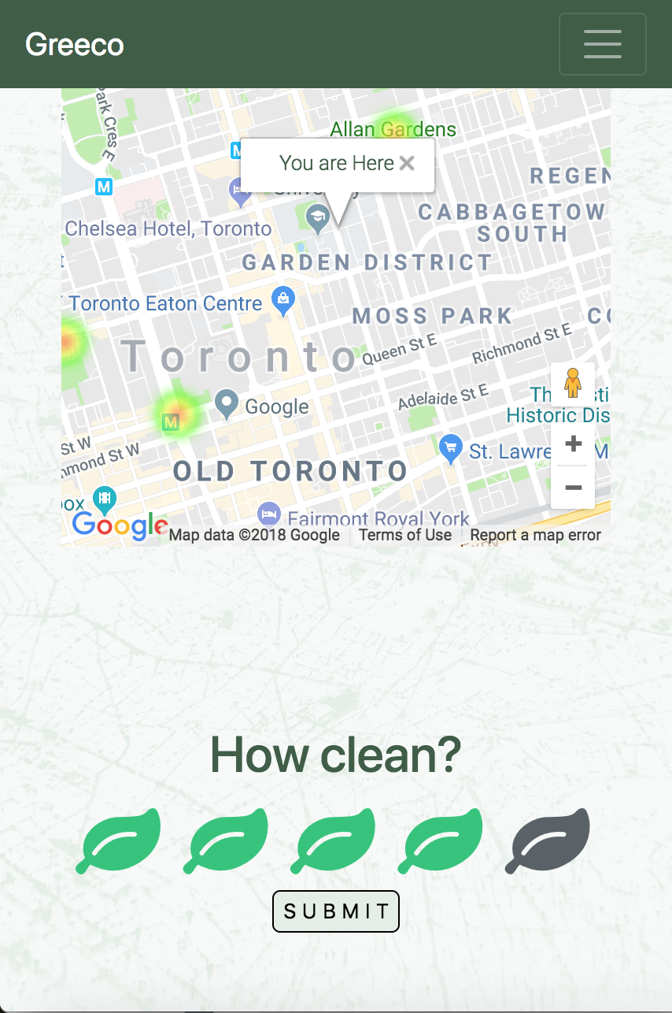
User Experience
Seamless experience for mobile & desktop
User must actively enable location
Rich visualization tools with Google Maps API
Live at http://greeco.tech

Slide 5
Just the Beginning
Community clean-up event organization
Social tools
Rank / points system – gamification
Historical data visualization

